Slide 1


Slide 2
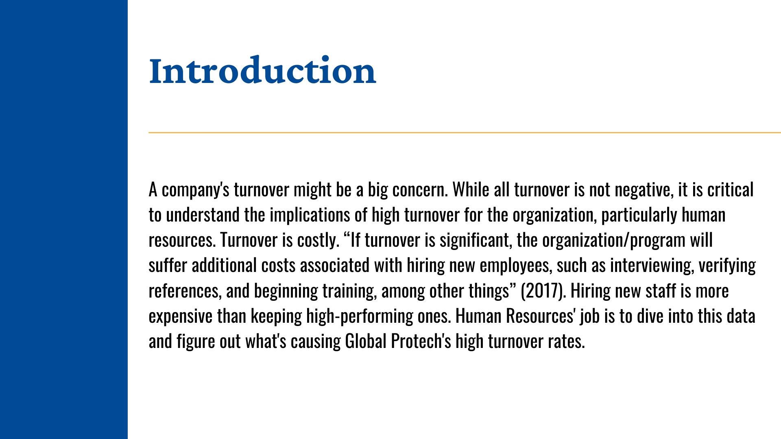
Notes:
We will discuss what inventory turnover is, how it impacts financial performance
of an organization and why it’s important to understand inventory turnover. To illustrate how
inventory turnover works in several industries, the paper will also explain normal inventory
turnover in Global Protech.Moreover, it will analyze
the purpose of holding inventory and provide steps organizations can take to increase the
accuracy of their inventory management

Slide 3
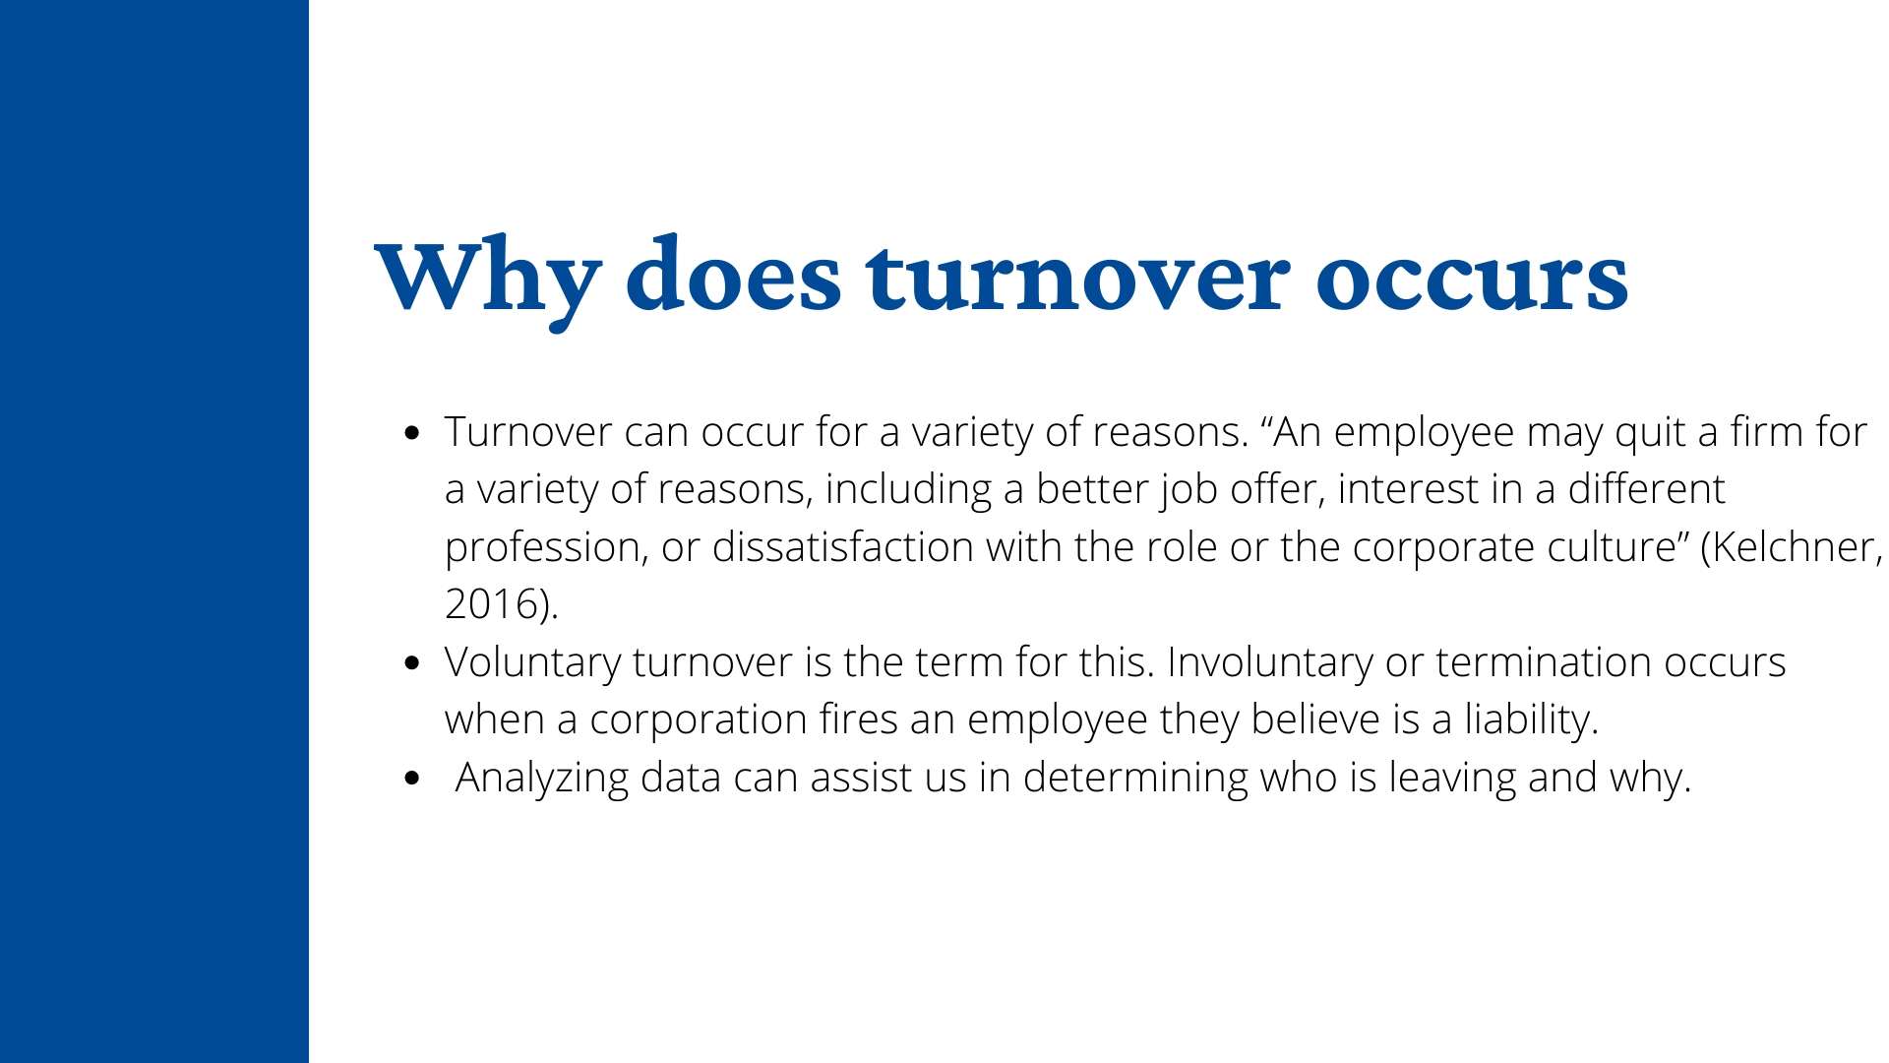
Notes:
Inventory turnover is a ratio used to show how much inventory an organization has sold
and replaced during a given period of time, showing how effective an organization is at
purchasing, producing and selling their inventory. Some organizations will use sales in the
equation but the issue with that is, sales is often reported at market value rather than actual value
and therefore, it is more accurate to use cost of goods sold (COGS)

Slide 4
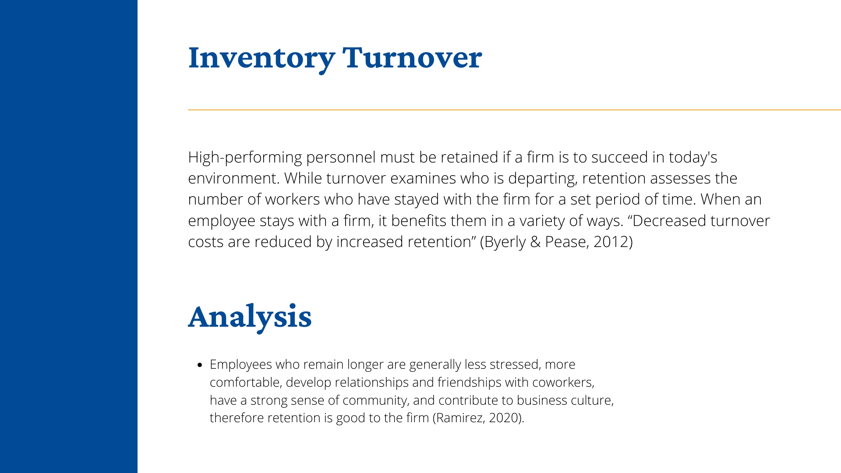

Slide 5
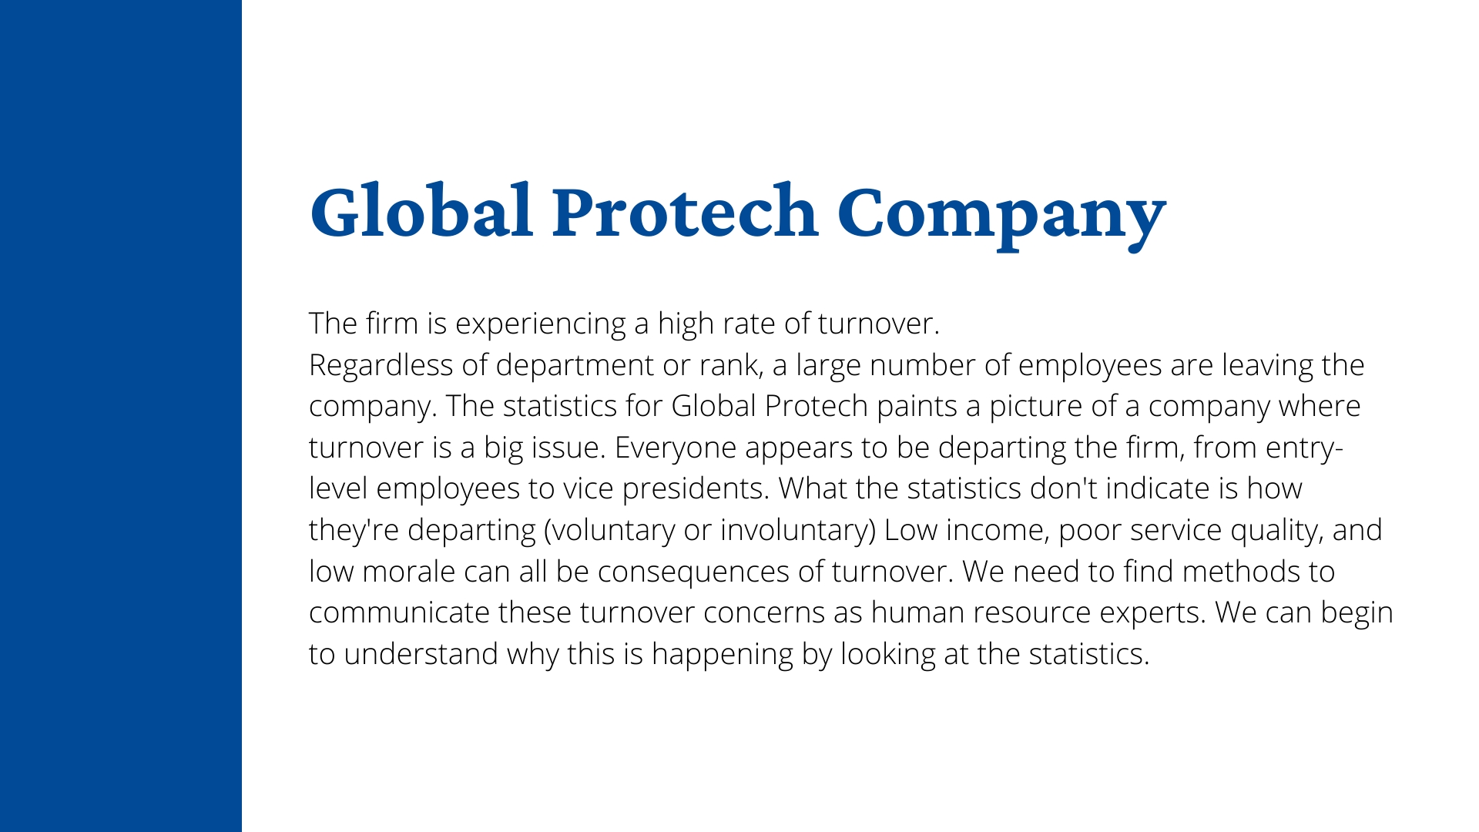
Notes:
The success of an organization relates to inventory to understand the needs and control of
inventory to avoid losing money when holding too much. The ratio of inventory turnover
provides the organization an image of the performance in certain areas.

Slide 6

Notes:
It shows the effectiveness of purchasing and selling the
inventory. Sales usually utilized in the equation by some organizations, but it often notified at
market value more than actual value thus it is accurate to use cost of goods sold (COGS). COGS
and sales both reported in the entire time while inventory is the same, inventory average is
utilized and let changes happen in inventory for certain levels to trends of signs in companyshows the effectiveness of purchasing and selling the
inventory.

Slide 7
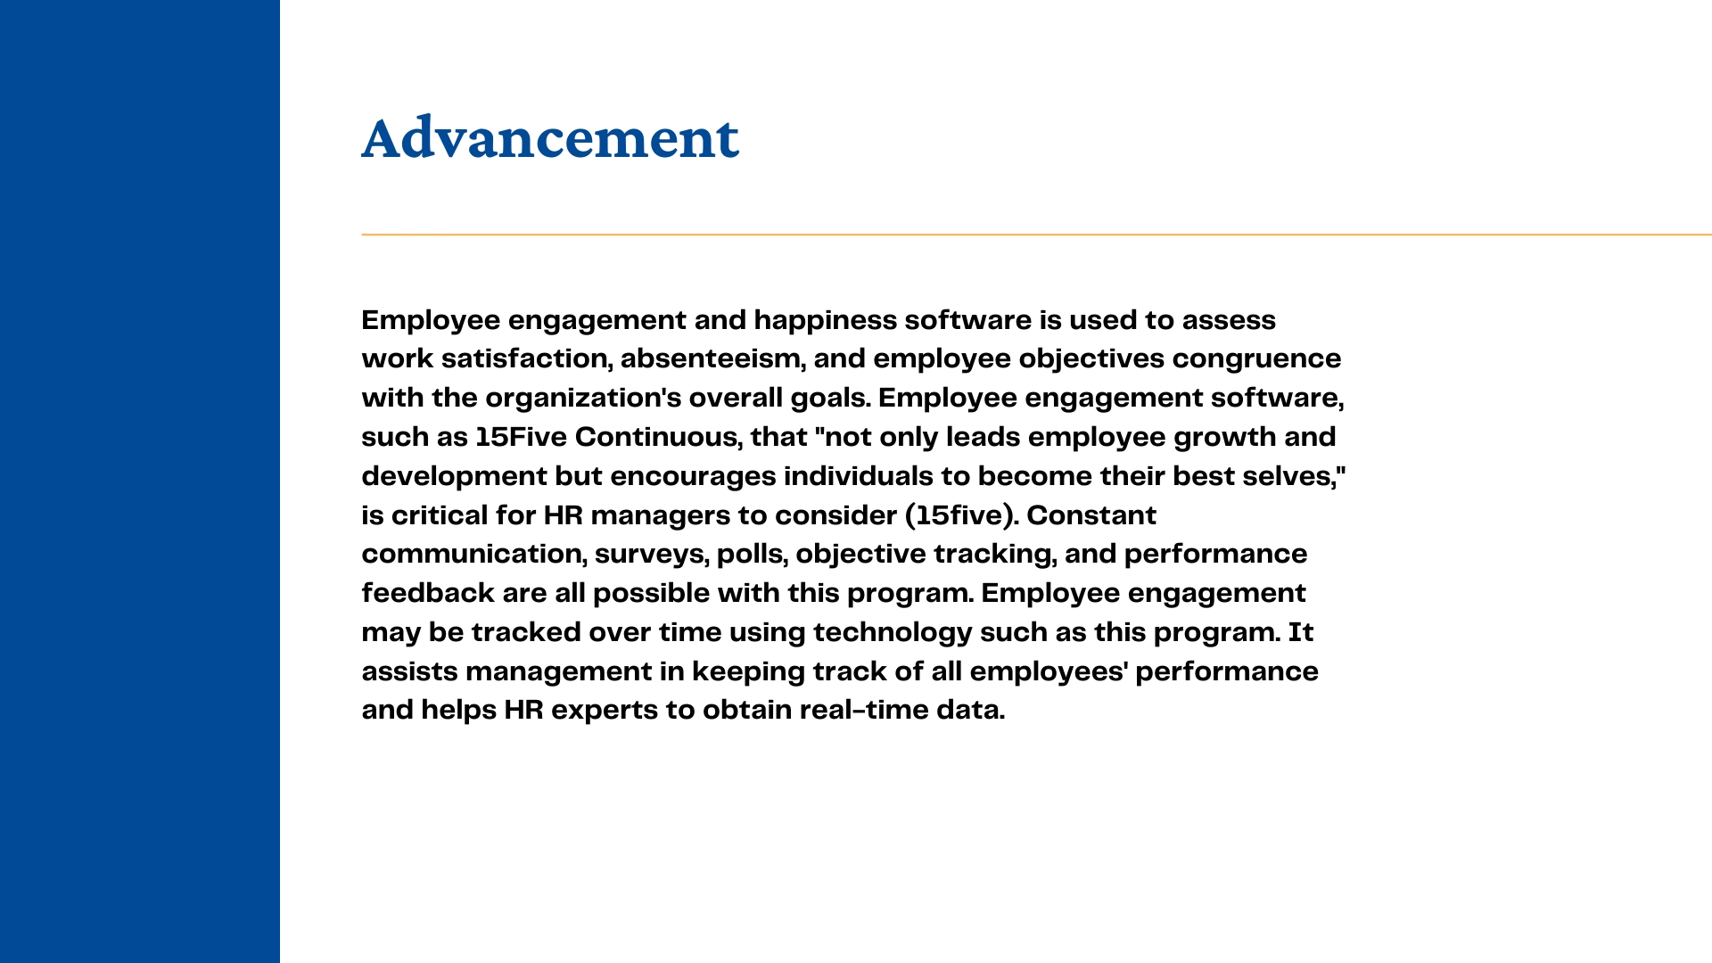
Notes:
Sales usually utilized in the equation by some organizations, but it often notified at
market value more than actual value thus it is accurate to use cost of goods sold (COGS). COGS
and sales both reported in the entire time while inventory is the same, inventory average is
utilized and let changes happen in inventory for certain levels to trends of signs in company

Slide 9
